Slide 1
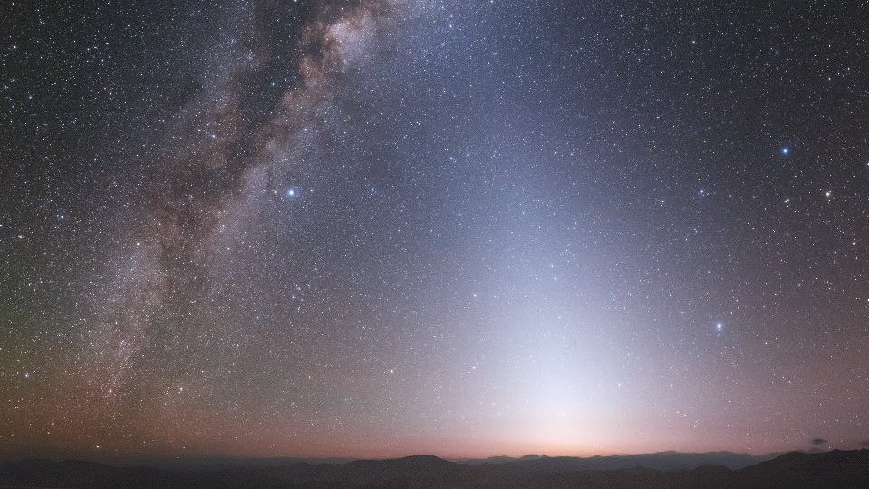




How to Give a Conference Talk
(and Good Talks Generally)
Alycia J. Weinberger
Carnegie Earth and Planets Laboratory
@AlyJWeinberger
Notes:
Talks should have a title slide that includes your name and affiliation. Optional: graphics and twitter handle.

Slide 2
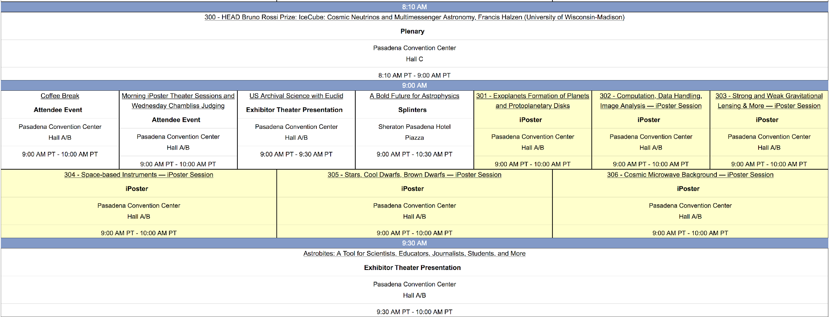
What a Scientific Conference is Like
Schedule is Packed!

Slide 3
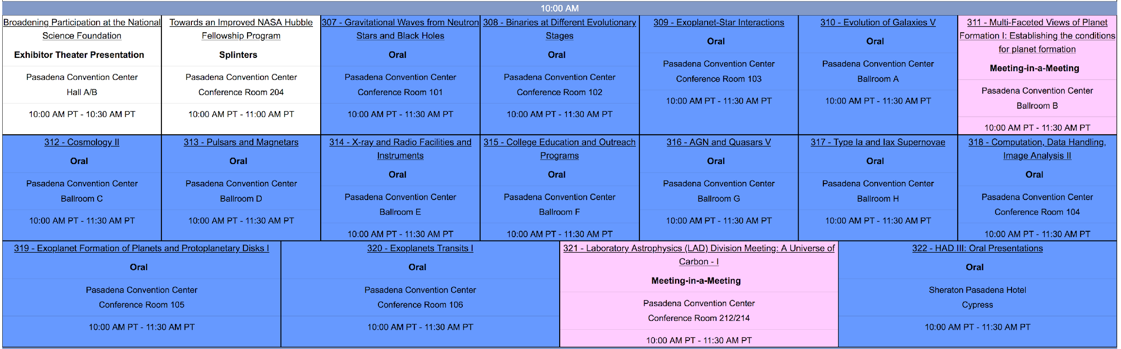
18 parallel sessions: and this was a small meeting

Slide 4
GOAL: Tell your audience something interesting
How we connect debris disks and exoplanet architectures and compositions
Why the star AU Mic is a great place to study disk – exoplanet connections
Astronomers ask “what” and “how” about the Universe
Planet formation is linked to habitability
Stars and planets form and evolve together
Imaging of the TW Hydrae Disk reveals structure
Subsidiary Goals:
Demonstrate you’re ready for graduate school / a job
Meet other researchers with similar interests

Slide 5
Six General Principles
GOAL: Tell your audience something interesting
Know your audience
Notes:
My first principle includes choosing a good title that conveys why the talk will be interesting without a lot of jargon, i.e. make your talk TITLE accessible and not so jargon-rich that it is intimidating. A conference talk is more to experts than other kids of talks, but still not everyone in the room will be an expert.
“In my talk today, I will tell you six general principles that I think all good talks must follow. As part of this, I will elaborate on how to design good visuals and I will discuss imposter syndrome as it relates to talks.” That’s my outline, and I hate actually showing the outline on a slide; I much prefer to hear/give it verbally.

Slide 6
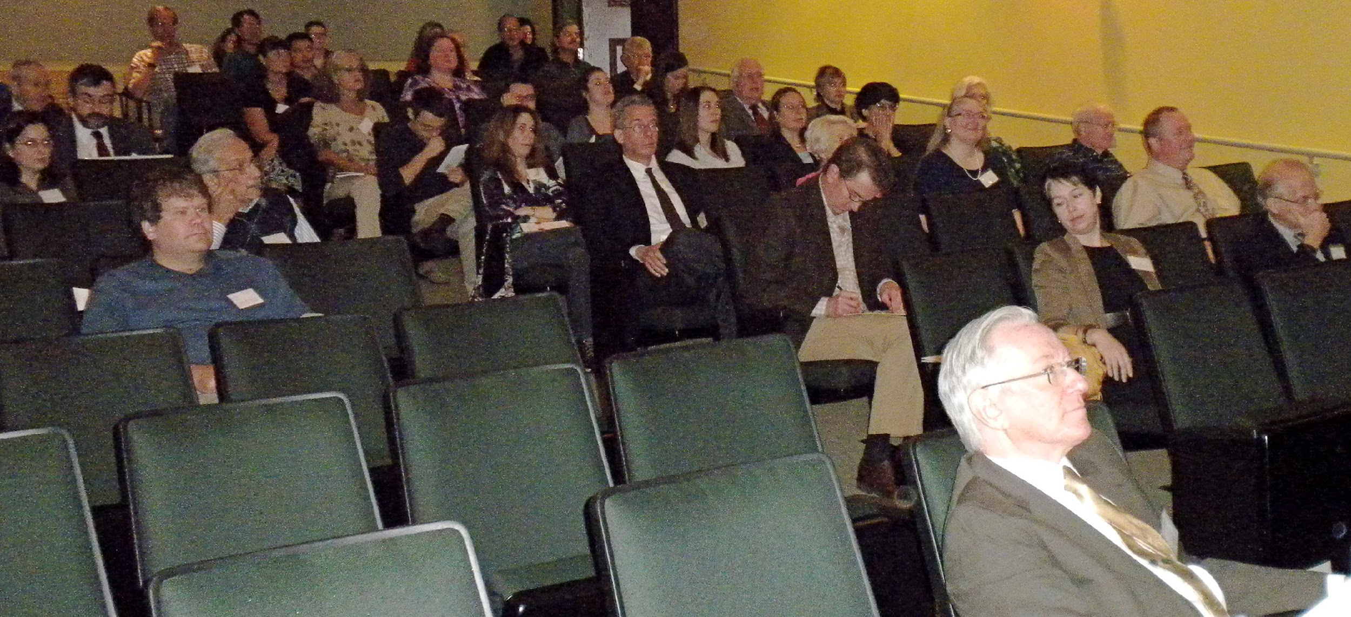
Know your Audience
New grad student
undergraduate
Expert in your field
Skeptical faculty more interested in something else
Faculty in a different and/or competing field
Notes:
Neugebauer’s (my thesis advisor) talk rule: Never underestimate how much audiences like to hear what they already know; it makes them feel smart.
In a full colloquium, you are NEVER talking only to experts in your field. Even if the department is purely astronomy, there will be 1st year grad students there and people who study something entirely different from what you do. You MUST convey why they should care about your work. Every single person should leave feeling smart and feel they learned something. So, yes, there must be some content detailed enough to satisfy even the expert.
Scope out your audience ahead of time via the department website. Be prepared to answer questions from the people you know inhabit that department.
Prepare backup slides aimed at specific people in the audience who might want more details than you are going to present to the room as a whole. Anticipating questions with backup slides is a killer technique.

Slide 7
Six General Principles
GOAL: Tell your audience something interesting
Know your audience
You must have an outline
Notes:
“In my talk today, I will tell you six general principles that I think all good talks must follow. As part of this, I will elaborate on how to design good visuals and I will discuss imposter syndrome as it relates to talks.” That’s my outline, and I hate actually showing the outline on a slide; I much prefer to hear/give it verbally.

Slide 8
You MUST Have an Outline
Introduction: (~2-3 min)
  What is the problem and Why you should care
  Your story arc
The Protein: (~8 min)
  Nourishes every member of audience
  Links to form your body (story arc)
The Conclusions: (~1-2 min)
  What we have learned about what you care about
  Where we will go next
Notes:
My first principle is that a talk must have an outline, which does not mean you have to show your outline to the audience. You must know what your talks’ purpose is, so that your talk has an arc from introduction through the details to the conclusions. I’m not a big fan of showing an outline slide in the actual talk. I prefer to tell you my story arc verbally, as I did on the last slide:

Slide 9
Six General Principles
GOAL: Tell your audience something interesting
Know your audience
You must have an outline
Practice, Practice, Practice
  Be comfortable and confident with your material
  Don’t use phrases that undermine your credibility
  Polish your delivery
Notes:
Practice. Know how long your talk takes. Once you’re experienced, you will know how much time per slide. We’ll talk about slide design later, but I like one idea and 1-2 minutes per slide.
Delivery issues: volume, speed, eye contact, enthusiasm – it may help to write out the talk and then practice it, so you remember what you want to say. Reading the talk itself is not ideal.
Specific points:
I can not emphasize enough to practice, practice, practice. You MUST make sure your talk fits in the allotted time without your having to talk at lightspeed.
Don’t show figures you aren’t comfortable with, like illustrations from the Web. Someone might ask you the details about them.
Nothing says nervous like a wiggly pointer. Nothing blinds like a laser pointer aimed at one’s eyes..
Record yourself, and then try to take out all the “ummms”
Practice for contingencies (see next point) such as if a movie or image fail to display properly; make backup slides for questions
Be prepared for questions
Have backup slides with details
Appoint an aggressive questioner at your practice talk
Don’t be dismissive in answering; show respect for the questioner
If you don’t know the answer, here are some strategies that came up in discussion: At least answer as much as you know to give the questioner some new information. Suggest where one might go to find the answer for the question (references). Admit you can’t give a complete answer and offer to discuss the issue further later.

Slide 10
Don’t Undermine Your Own Credibility
What You Do Say | What You SHOULD Say
I believe this figure shows… | I show in this figure…
I think this figure shows… | I demonstrate/show/present
This figure sort of shows | This figure shows…
This figure just shows | This figure shows…
There are other, I guess, examples | There are other examples
Uh, um, mm | [pause and take a breath]
Notes:
I too often see speakers use phrases that convey uncertainty rather than confidence. The one that annoys me the most is “this figure just…” You are presumably showing figures to make a point, whereas saying, “just” implies that the figure is not important. If you are dismissive of your results, the audience will be too.
I’m ignoring here my advisor’s other advice: Never show a table.

Slide 11
Six General Principles
GOAL: Tell your audience something interesting
Know your audience
You must have an outline
Practice, Practice, Practice
Dress well
Notes:
Your dress conveys a certain seriousness of purpose. My rule is to dress as nicely as you think the most nicely dressed person in the audience will be dressed. But don’t make yourself so uncomfortable that it throws off your talk or doesn’t allow you to take a campus tour.
It’s handy to have a place to clip a microphone and a place to hook the microphone base. Jackets/blazers are great for this.

Slide 12
Six General Principles
GOAL: Tell your audience something interesting
Know your audience
You must have an outline
Practice, Practice, Practice
Dress well
Make good slides and use them well

Slide 13
Using Slides to Communicate Effectively
Make slides for your audience, not so much for you
  Convey something important on every slide
  Use slides for what just words won’t do
This slide did not have to exist, unless it helps your audience to assimilate or remember what you said
Notes:
What makes a good slide?
Conveys something important
Conveys something not so easily told or absorbed only if told, i.e. it is not just words or even mainly words. Every figure should serve a purpose, so should every word. Reminding yourself what to say is a purpose but not the best one. That’s why I’m using this notes section instead!
A few notes:
For maximum compatibility in PowerPoint, insert graphics, don’t drag and drop; if you’re worried, generate a PDF
Know how to copy your talk to another computer including movies if you have them
When you make slides, consider:
have you used projector/screen before -- will it cut off edges of slides / have enough contrast
Will you be able to see the screen
3. Aspect ratio of room
For my talks, 1 slide is 1 idea = 1-2 minutes
Non-native speakers may find some words helpful to assimilate the information.

Slide 14

My opinion on slide design
One good figure will fit on a slide and be worth 1000 words, if it’s readable. Describe the axes and what it shows!!!!
A title helps the audience understand what you’re talking about
ALWAYS give a credit!!!!
A conclusion lets them catch up if they fall asleep
Who did the work and is the expert – You!!!
Powerpoint clipart (better if it’s yours)
Let every slide make a point, and make it clear what this point is.
Notes:
I like having a title that reminds the audience what we’re talking about and a conclusion (in yellow) that reminds the audience what the point of this slide or section is. A nice figure that illustrates the point is necessary in a science talk, where we find data more credible than words. Other words may be added to give details to the cognescenti, as long as they can be made large enough to read.

Slide 15
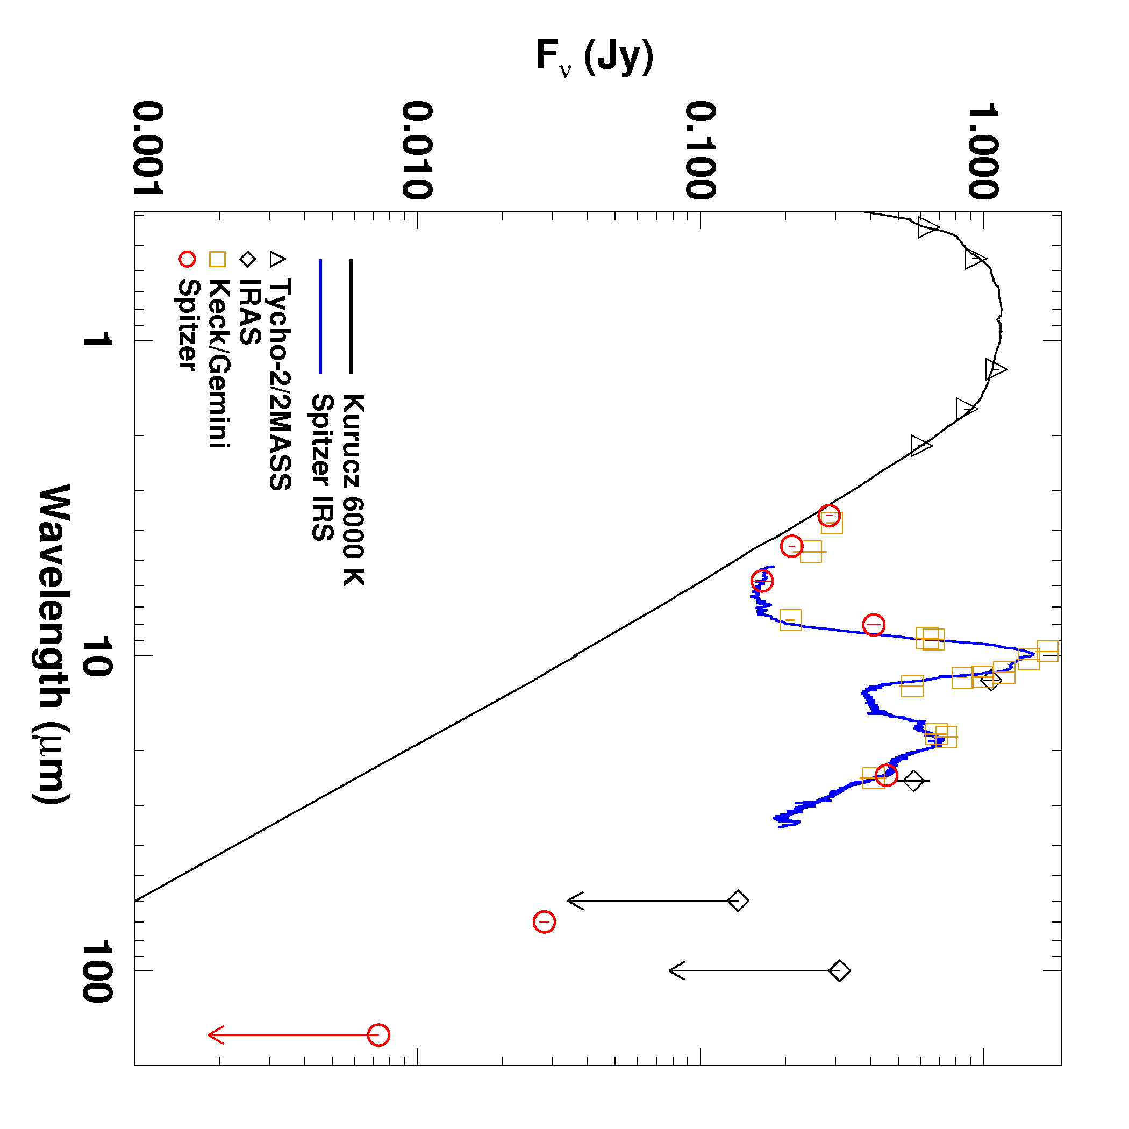
A Mediocre Slide
Infrared spectrum is unique
10 micron flux is huge
All far infrared flux arises from hot dust
Notes:
This is a slide I stole (in design) from a presentation on-line in order to make a point. Why waste all that space just showing off a gray background and a huge title area? Plus, the bullet points take up so much room, that the figure has to be made smaller (a particular problem with square figures, as Anat pointed out). Instead, make the figure bigger and easier to see and take off unnecessary words.

Slide 16
A Good Slide
10 micron flux is huge
All far infrared flux arises from hot dust
A giant planetary collision had to make the dust
Weinberger et al. 2011
Notes:
Here’s my re-do of the slide. I preserved all the important text. I still don’t like the white on gray as I think it’s too hard to read.
----- Meeting Notes (10/28/11 14:21) -----
Dispense with the title? This allows you to make the figure bigger at the risk of eliminating helpful words to those who may not be paying full attention.
Remember to describe the axes! This plot shows flux density in Janskys as a function of wavelength from the visible to far infrared.
Remember to describe what people are supposed to take away! You can see the enormous excess above the stellar photosphere shown in black and the prominent silicate emission peaks. The blue line shows the Spitzer spectra with the other points showing photometry form a variety of missions.

Slide 17
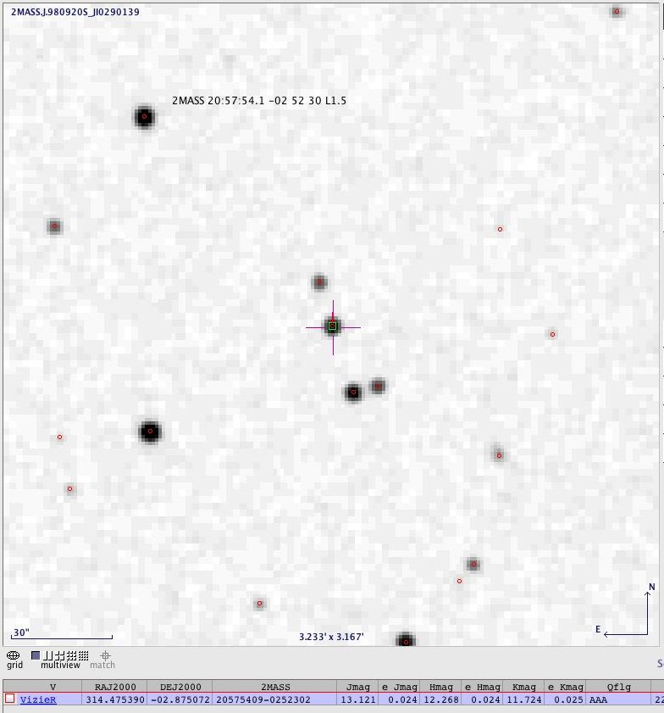
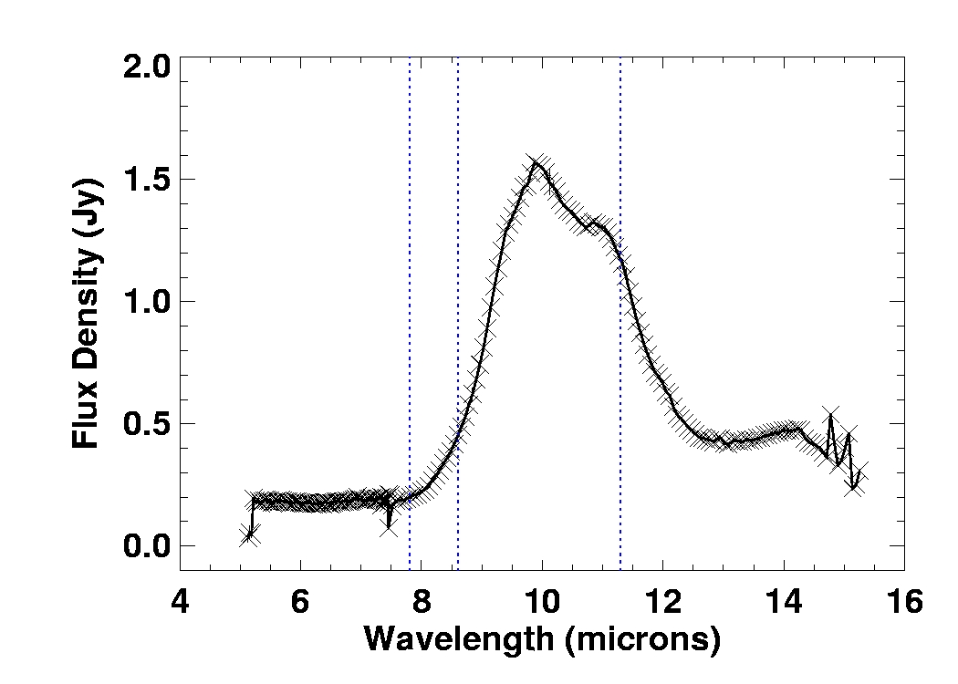
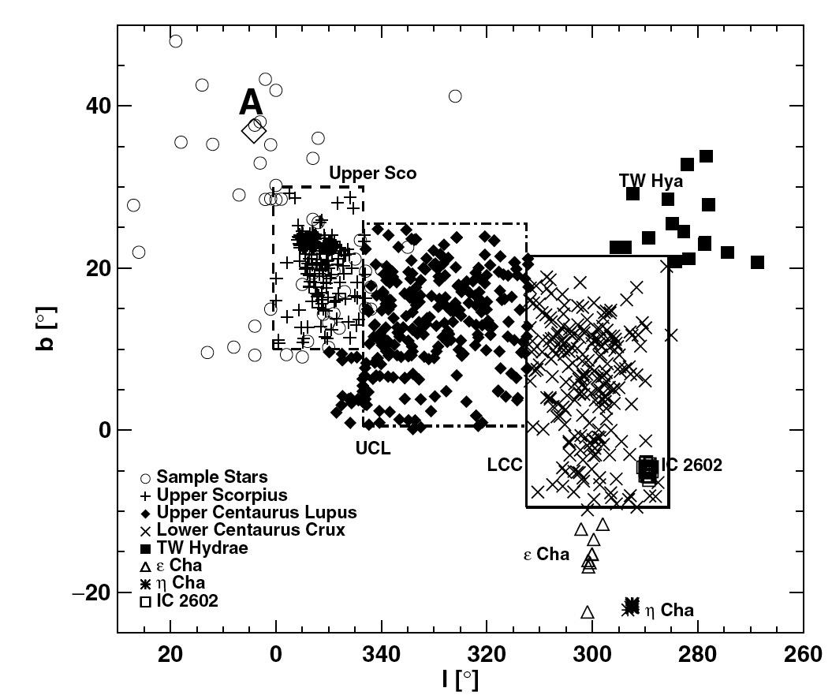
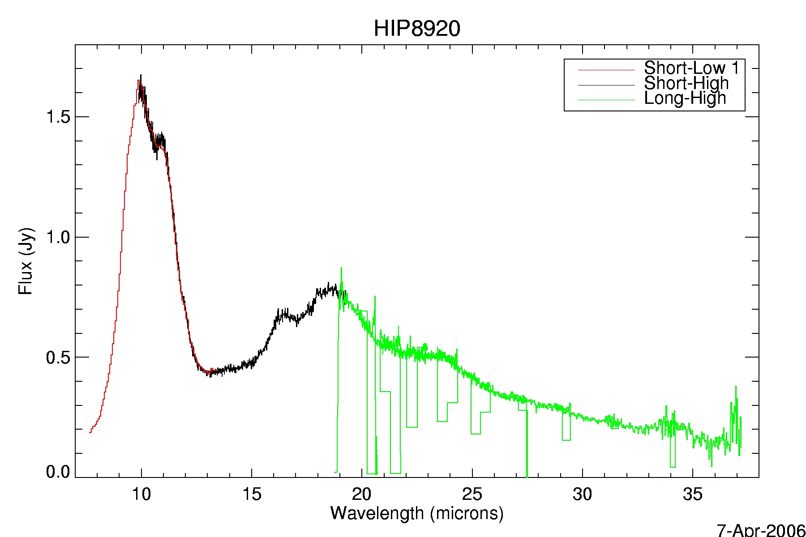
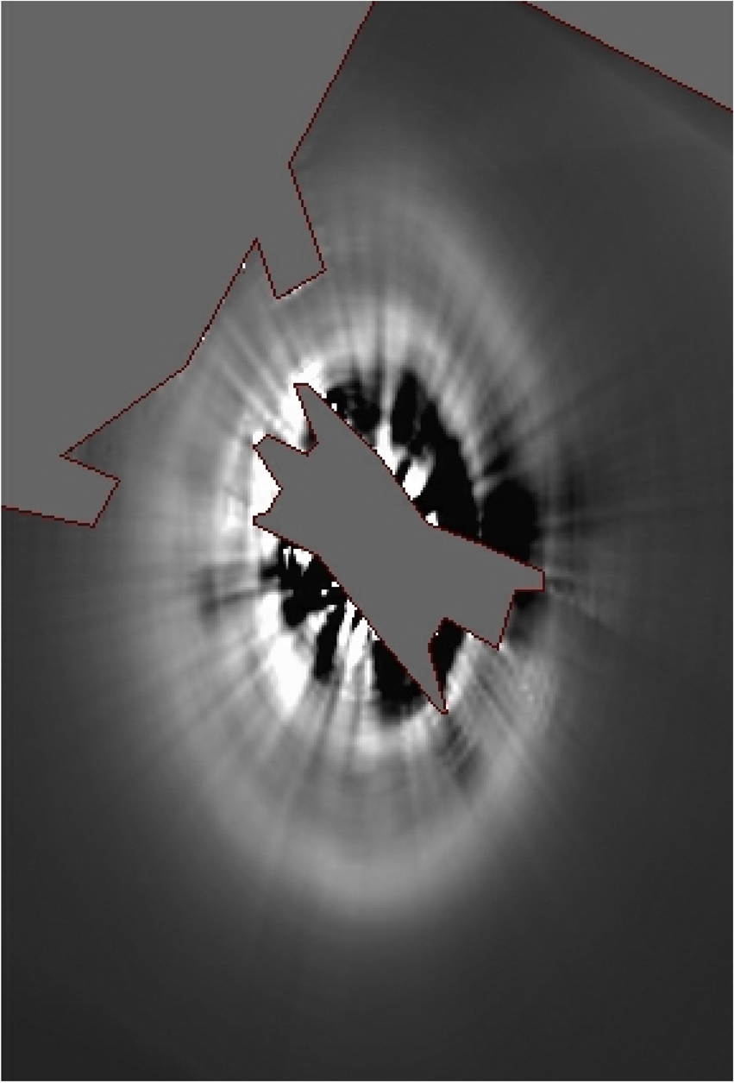
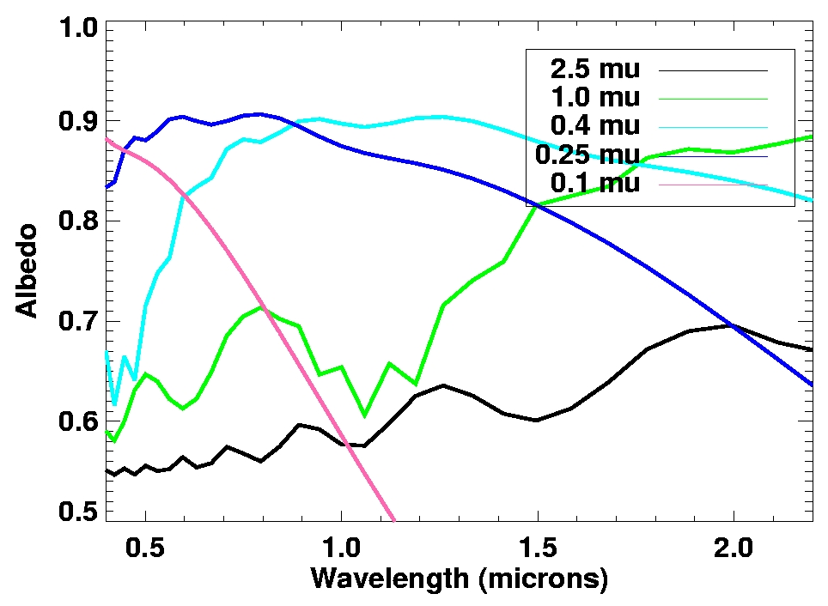
Another Mediocre Slide
Notes:
You’re thinking – I’m going to impress my audience with all the different things I can do! And instead, no one can read anything and so they aren’t impressed that you’re presenting a muddle.
The axes aren’t readable; the labels aren’t readable; the plots aren’t labeled with what point they make. Just. No.

Slide 18
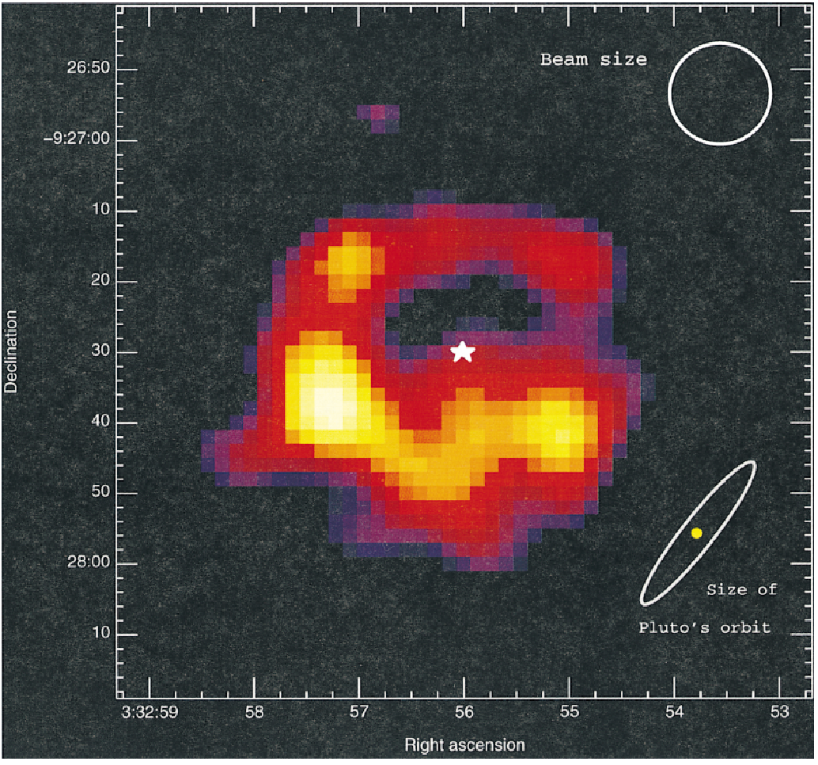
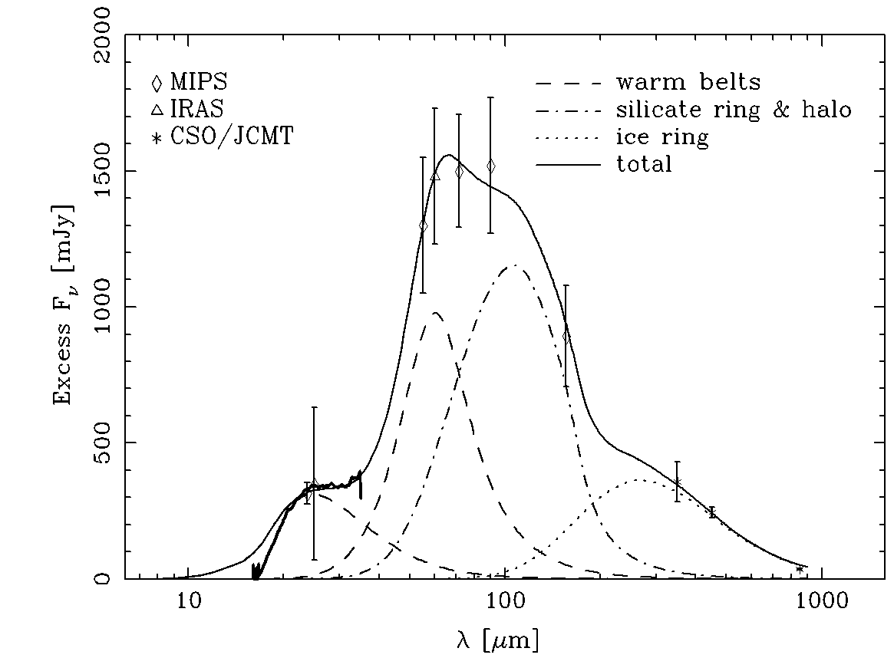
3. Rings and Gaps
Submm Image: R~64 AU
SED: Warm dust ring
Example
(amidst many):
ε Eridani
K2e
400-800 Myr
DEC
RA
Greaves et al. 1998
also MacGregor et al. 2015,
Booth et al. 2017
Backman et al. 2009
also Su et al. 2017

Slide 19
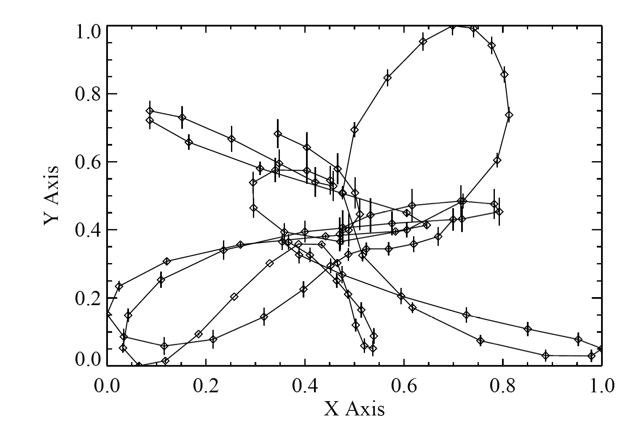
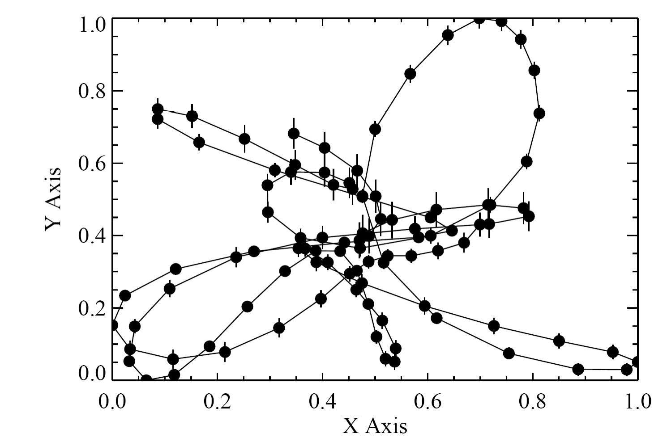
Start with Good Figures
Y Axis
X Axis
18 pt type
12.5 pt type axis
Thanks to Larry Nittler for plot examples
Notes:
Making labels bigger on figures in papers helps readability in your paper’s PDF and also when inserted into talks.
Remember, you WANT others to use your killer figures in their talks too, so make it easy on them!
It’s also important to know how to get a Figure at high quality. These were cut from a PDF viewed with Preview and then saved as PDFs. Saving them as JPEG or PNG files greatly reduced their quality. When it doubt, test your slides out on a projector! Also, you should know how to adjust the display resolution in case you need to do that to make the figures look sharp.

Slide 20
HD209458b,HD189733b,XO-1b
Please:
Eschew complicated backgrounds
Conferences sometimes post talks; people will steal your slides; label them!
HD 209458b
Mass= 0.69 Mj; Radius = 1.32 Rj;
Parent star= G0
Distance = 0.045 AU;
HD 189733b
Mass = 1.15 Mj; Radius= 1.156 Rj;
Parent Star = K1-K2;
Distance= 0.0312
Notes:
‹#›
This slide was from a talk that was posted on a conference site and I stole it as an example of what not to do-- NOTE: it does not contain its authorship or other credit anywhere on it. If you’re going to have your slides posted, put an attribution on each slide. To make it harder for others to simply steal your slides, you may want to post only PDFs.
I couldn’t find a font color that worked well here. Eschew complicated backgrounds.

Slide 21
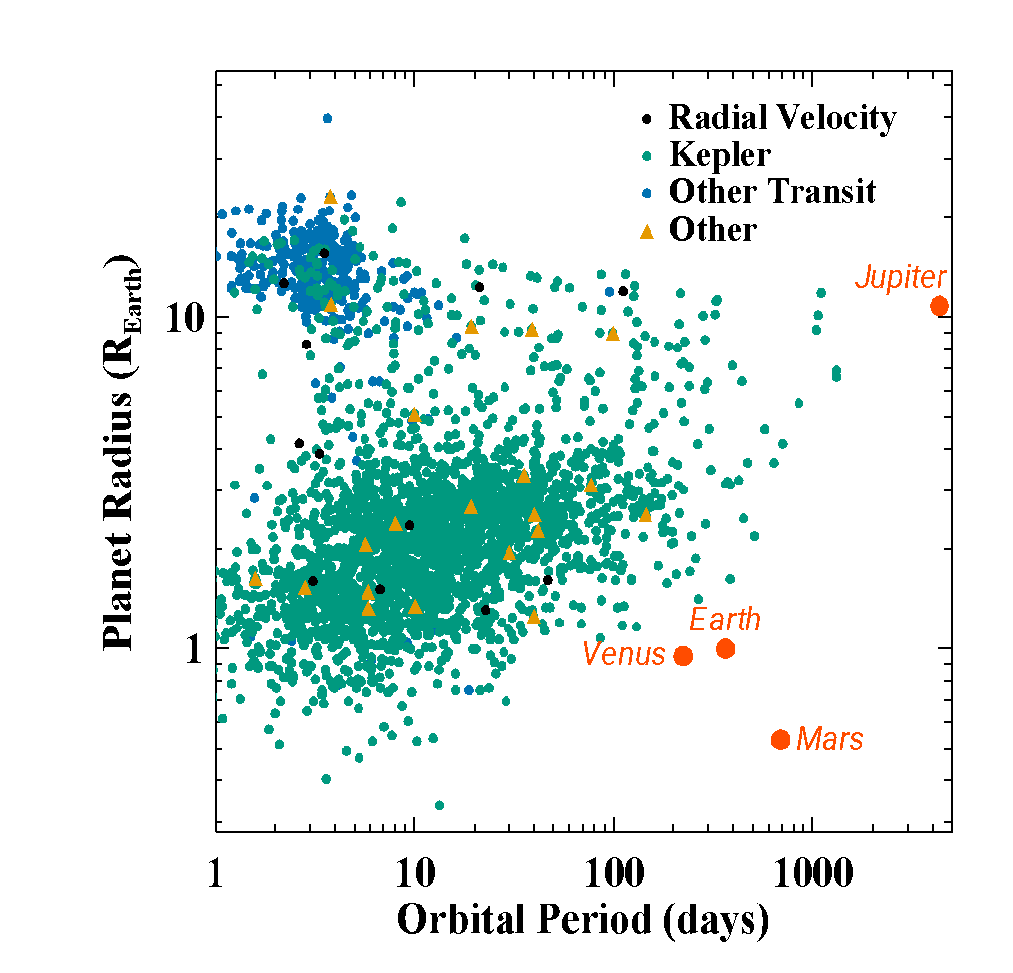
Limit your Animations
The most common type of planet we know about in our Galaxy is missing from our Solar System
Notes:
How does the diversity of planets come to be?
Is the Solar System Rare?

Slide 22
Limit your Animations
I’m so distracted, I have no idea what this slide says!
The most common type of planet we know about in our Galaxy is missing from our Solar System
Notes:
How does the diversity of planets come to be?
Is the Solar System Rare?

Slide 23
Screen Sizes May Not Scale with Room Size
V = (screen width / room length)
Tuve
  V = 6 ft / 35 ft = 0.17
ACC
  V(Screen) = 8 ft / 24 ft = 0.3
  V(TV) = 5 ft / 24 ft = 0.21
Greenwalt Seminar Room
  V = 9.25 ft / 45 ft = 0.20
AAS Ballroom
  V = 8 ft / 90 ft = 0.09

Slide 24
Six General Principles
GOAL: Tell your audience something interesting
Know your audience
You must have an outline
Practice, Practice, Practice
Dress well
Make good slides
Confront your imposter syndrome

Slide 25
Talks and Imposter Syndrome
Your achievements are the data to combat imposter syndrome
    Talks are a chance to rehash your successes
Overcoming the fear of questions: Remember, sometimes good enough is good enough
  If you get a hard question – give some extra information, offer to discuss later
Practice!
Notes:
Define Imposter Syndrome: the persistent inability to believe that one's success is deserved or has been legitimately achieved
Accompanied by chronic self-doubt and sense of being a fraud.

Slide 26
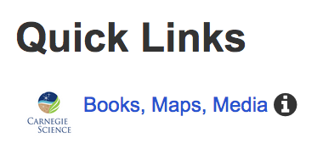
BBR Library Resources
Provided by Shaun Hardy
See Library website: https://library.carnegiescience.edu
➡ Quick Links … Books, Maps, Media
➡ Find Books on … Preparing Talks, Posters, and Graphics
Examples:
The craft of scientific presentations : critical steps to succeed and critical errors to avoid / Michael Alley
Dazzle 'em with style : the art of oral scientific presentation / Robert R.H. Anholt
Preparing scientific illustrations : a guide to better posters, presentations, and publications / Mary Helen Briscoe
Visual explanations : images and quantities, evidence and narrative / Edward R. Tufte
Information graphics : a comprehensive illustrated reference / Robert L. Harris

Slide 27
Leave your conclusions as your last slide while you take questions
Know your audience
You must have an outline
Practice, Practice, Practice
Dress well
Make good slides
Confront your imposter syndrome
aweinberger@carnegiescience.edu, R-261

Slide 28
Backup Slides

Slide 29
Useful reference websites:
Color Universal Design:
http://jfly.iam.u-tokyo.ac.jp/color/
“The Woman Physicist’s Guide to Speaking” by Heidi Newberg (RPI): http://homepages.rpi.edu/~newbeh/WIPcommText.htm

Slide 30
Let’s Talk Font Sizes
32 pt: My very exciting conclusion
28 pt: My very exciting conclusion
24 pt: My very exciting conclusion
20 pt: My very exciting conclusion
18 pt: My very exciting conclusion
16 pt: My very exciting conclusion
14 pt: My very exciting conclusion
12 pt: My very exciting conclusion
Notes:
The consensus is that 20 pt is the minimum size you should use.
Also, it’s nice to have your text arranged neatly (use align objects)

Slide 31
Eschew Gratuitous Use of Color
Remember that 5-7% males find Red and Green hard to distinguish/see
Projectors are often not very bright or high contrast
White Cyan Green Red Yellow Orange Purple Blue Magenta Banana Silver
Black Cyan Green Red Yellow Orange Purple Blue Magenta Banana Silver
Black Cyan Green Red Yellow Orange Purple Blue Magenta Banana Silver
Notes:
ROOM brightness and PROJECTOR brightness matter! Use high contrast. For more information on how to make plots readable by the color-blind, see http://jfly.iam.u-tokyo.ac.jp/color/

Slide 32
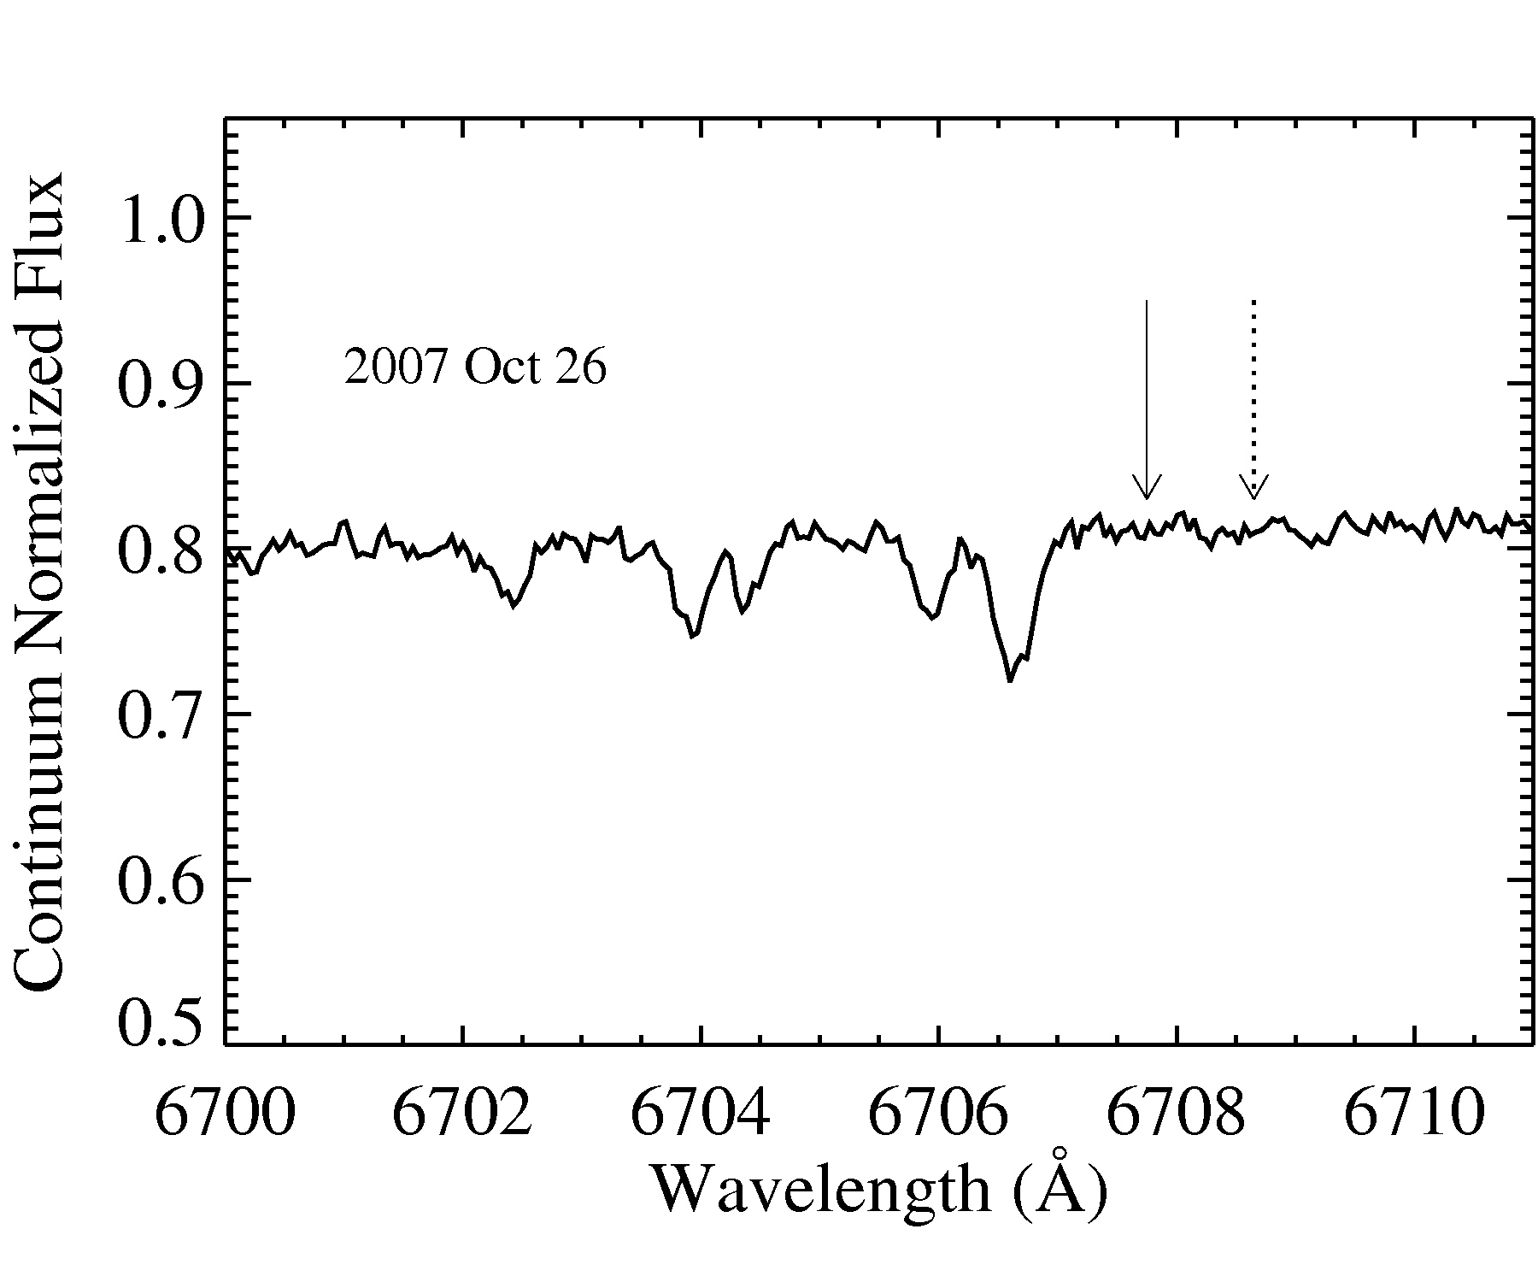
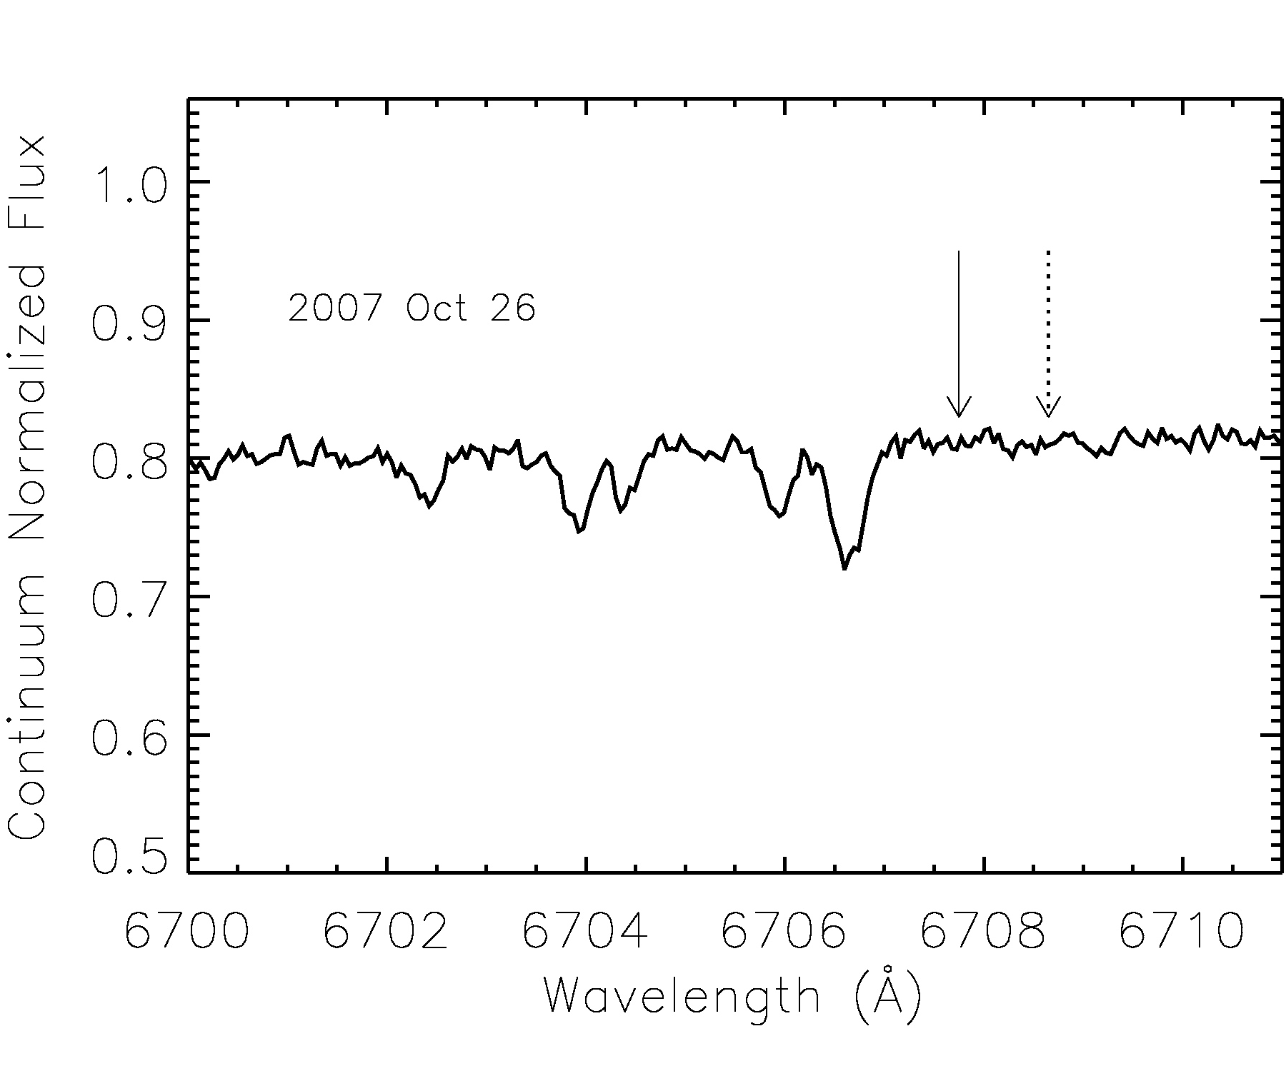
Use large fonts & thick lines
Thick = 3
Thick = 4
(16 pt equiv)
Postscript Times-Roman
Default IDL Vector font
xthick = 3
Notes:
It’s really hard to fit two figures on the same slide AND have the axis labels be a good size.
Thick lines really help!

Slide 33
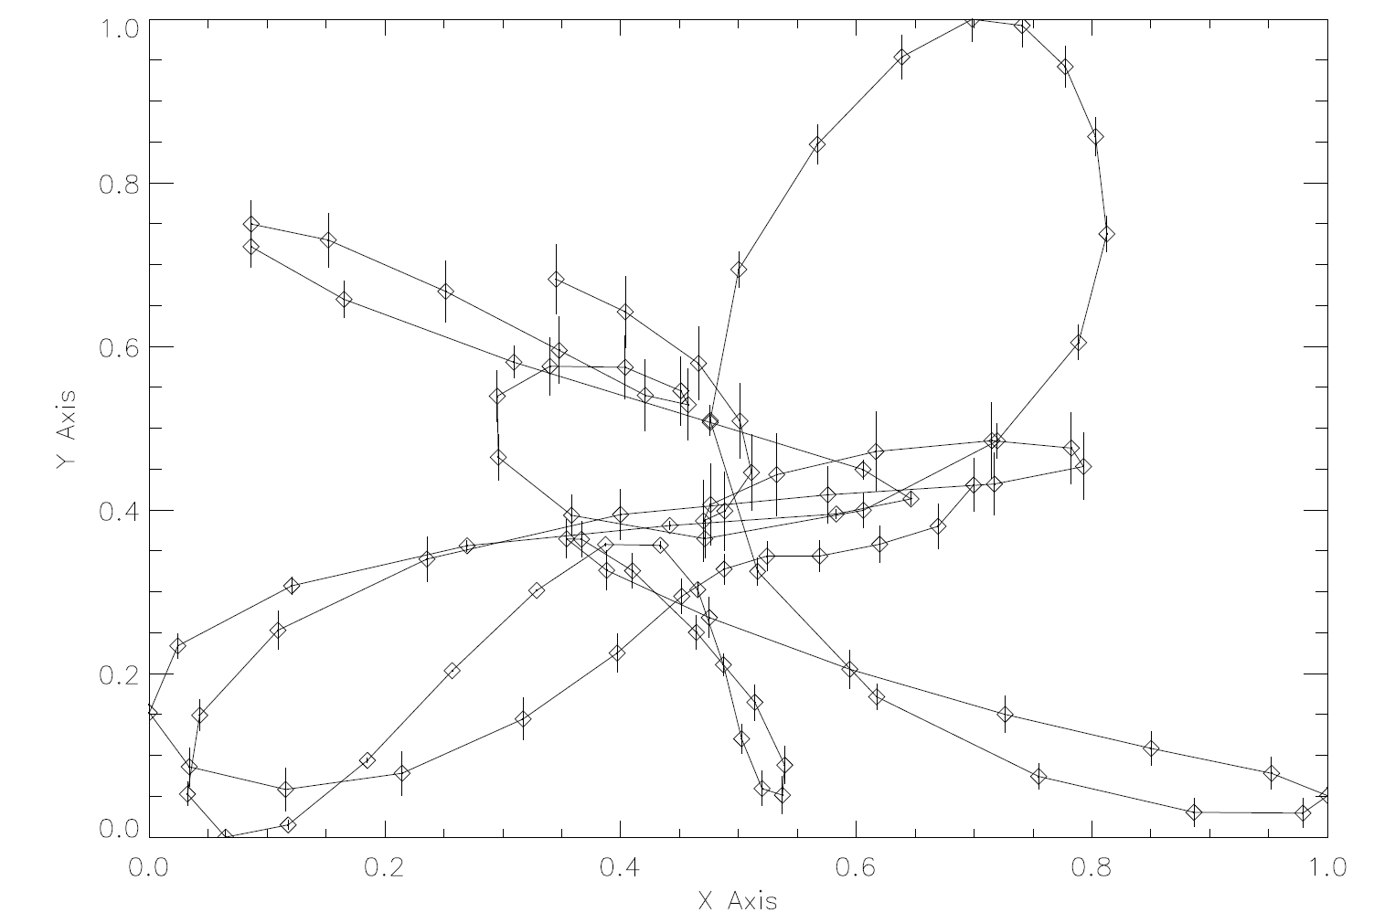
Not so good
(Examples on these slides thanks to Larry Nittler)
plot,x,y,/nodata,xtitle='X Axis',ytitle='Y Axis’
oploterr,x,y,yerr,3
oplot,x,y,psym=-4
Notes:
IDL commands that generated the plot are shown.

Slide 34
Better
!p.thick=3
plot,x,y,/nodata,xtitle='X Axis',ytitle='Y Axis', charsize=1.5, xthick=3, ythick=3
oploterr,x,y,yerr,3
oplot,x,y,psym=-4
Notes:
Changes from previous slide are shown in red.

Slide 35
Best
!p.thick=3
plot,x,y,/nodata,xtitle='X Axis',ytitle='Y Axis', charsize=1.5, xthick=3, ythick=3
oploterr,x,y,yerr,3
oplot,x,y,psym=sym(‘cir’,/fill), symsize=1.5
Notes:
The only change from the last slide is the symbol, but it had the effect of making the whole plot bolder

Slide 36
Font Test Slide
This is a serif (Times Roman) font at 28 pt
This is a sanserif (Arial) font at 28 pt
This is a serif font at 20 pt
This is a sanserif font at 20 pt
Is one easier to read than the other?
Notes:
I don’t have strong feelings about this, but some people do.

Slide 37
Figure Sizes and Whitespace
Notes:
These figures fit in the same size box, but the one on the right makes all the important things bigger by leaving less white space. Powerpoint has great tools for cropping and scaling. Use them!

